Slide 1
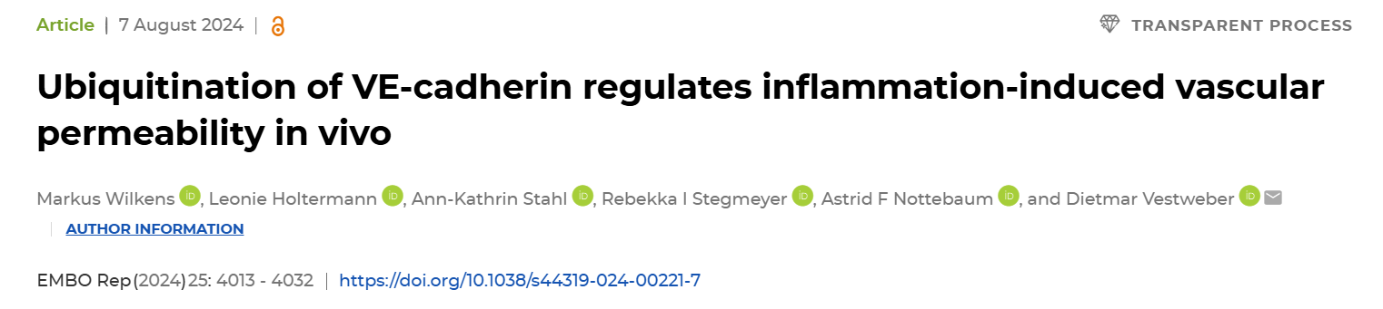
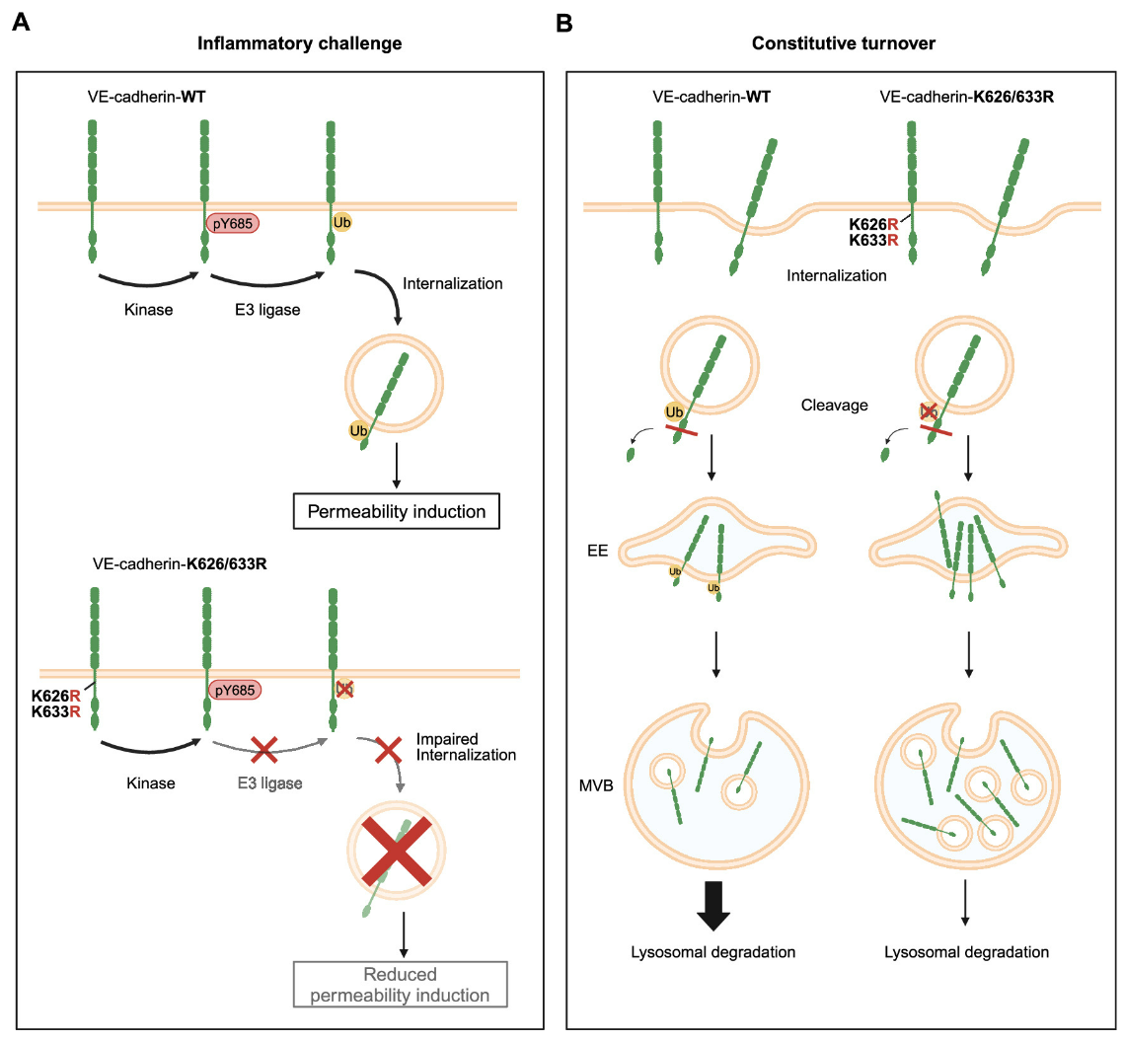
https://www.embopress.org/doi/full/10.1038/s44319-024-00221-7
2024/9/26 Hongyu Liu

Slide 2
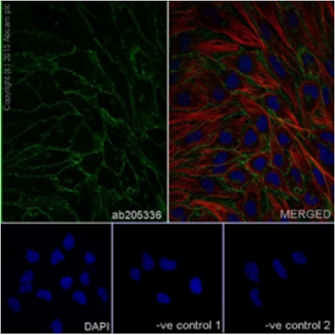
VE-Cadherin
血管内皮钙粘蛋白(VE-cadherin)是II型经典钙粘蛋白家族细胞粘附蛋白的成员，介导血管内皮内的同质性粘附。
在连接细胞时，它们优先以亲和性的方式与自己相互作用；因此，钙粘蛋白可能有助于异质细胞类型的分类。
定位于细胞连接处、细胞膜。

Slide 3
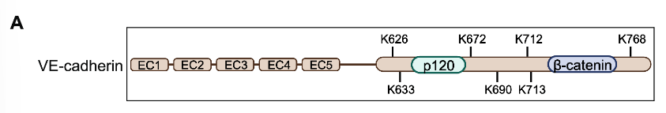
Inflammation-induced ubiquitination of VE-cadherin targets K626 and K633
K626R, K633R, K672R, K768R, K690R.
the double mutants K626/633R and K712/713R .
a mutant with all 7 lysine residues replaced by arginine residues (KallR).
fused to EGFP at its C-terminus.

Slide 4
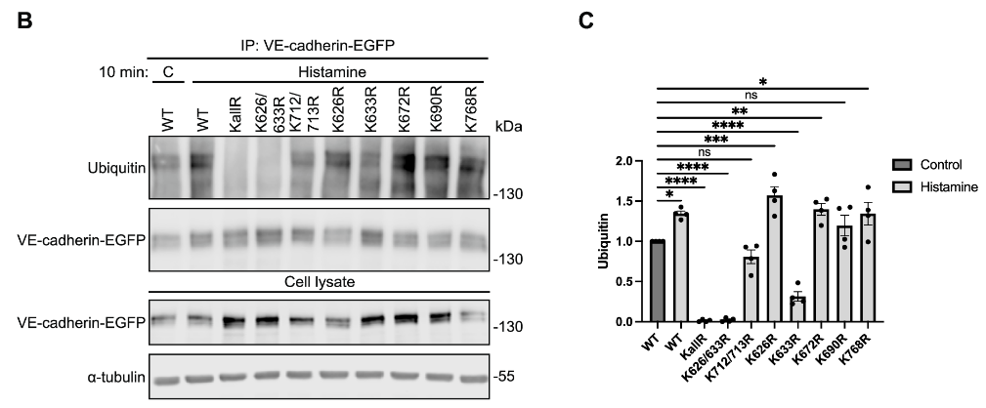
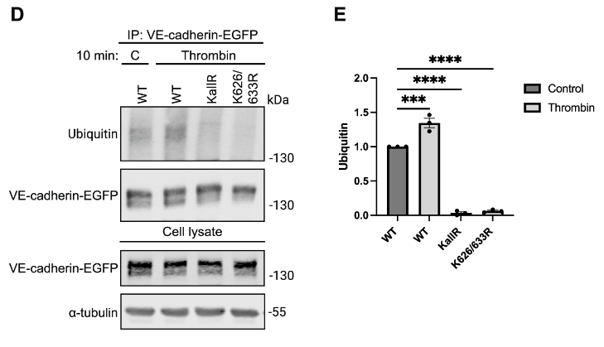
Histamine treatment increased ubiquitination of WT VE-cadherin and of most of the mutated constructs except for the K626/633R and the KallR constructs.
Mutation of the single K633 amino acid had a partial inhibitory effect on ubiquitination.
The same results in thrombin.

Slide 5
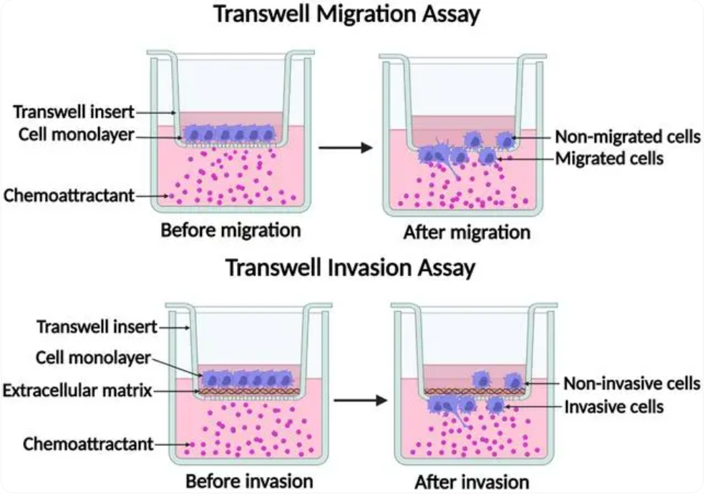
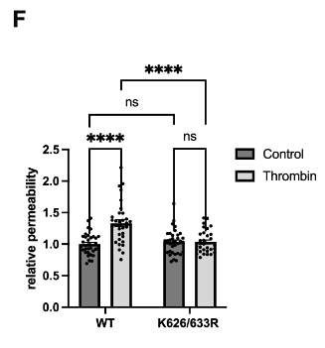
the significant increase of thrombin-induced permeability for 250 kDa FITC-dextran across WT VE-cadherin expressing cells was blocked by the K626/633R mutation

Slide 6
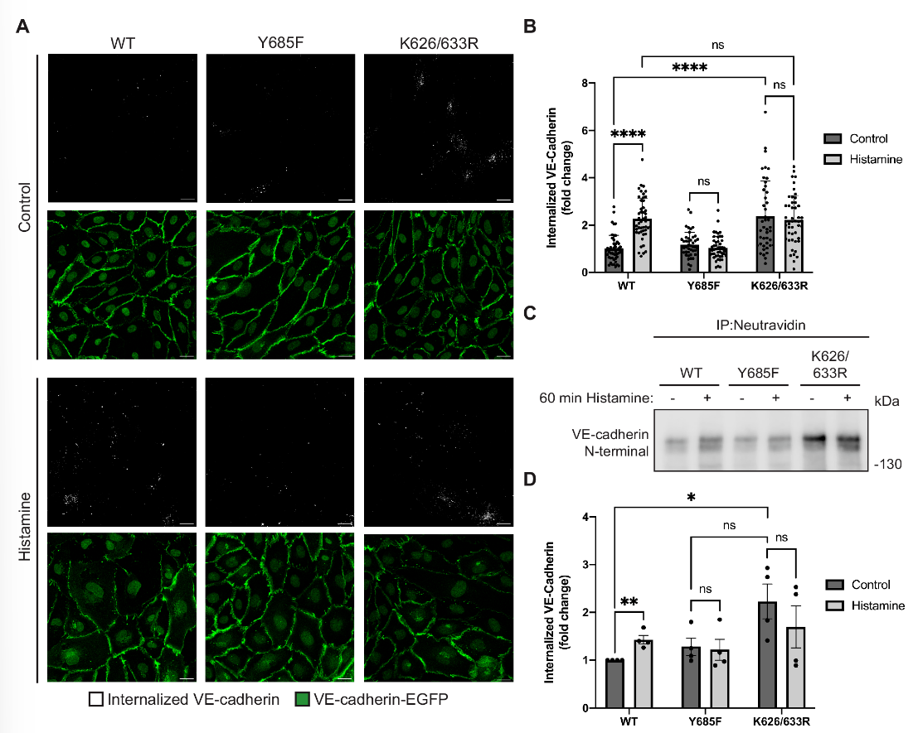
VE-cadherin endocytosis induced by inflammatory mediators requires K626 and K633
a significant increase of histamine-induced endocytosis of WT VE-cadherin, whereas this effect was blocked by the Y685F and the K626/633R mutations.
a higher level of intracellular VE-cadherin-K626/633R than of WT VE-cadherin in cells that were not histamine-stimulated
impaired lysosomal targeting and degradation of VE-cadherin-K626/633R

Slide 7
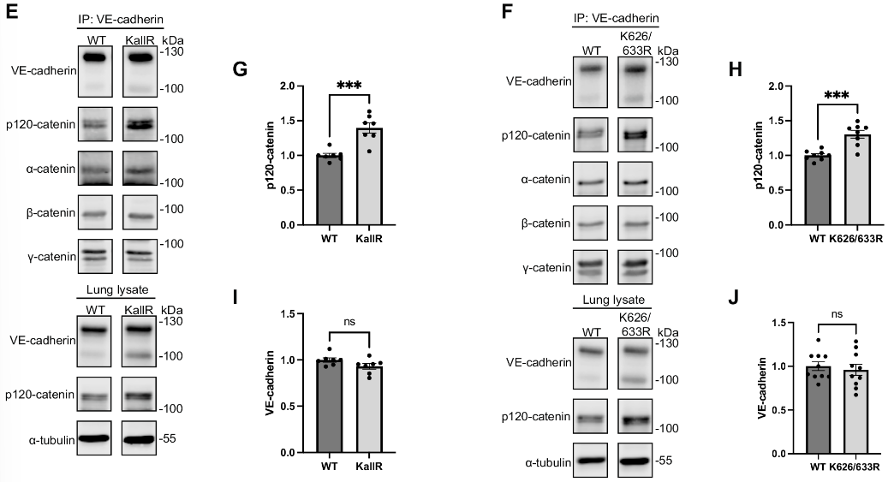
Generation of K626/633R and KallR point mutated VE-cadherin knock-in mice

Slide 8
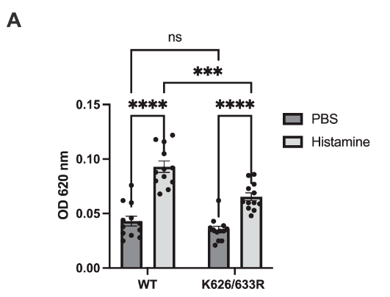
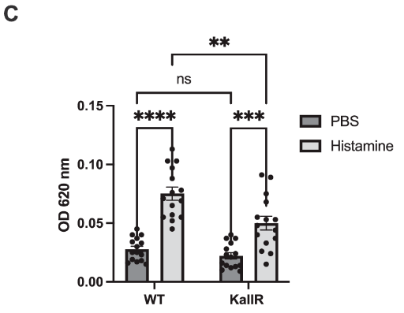
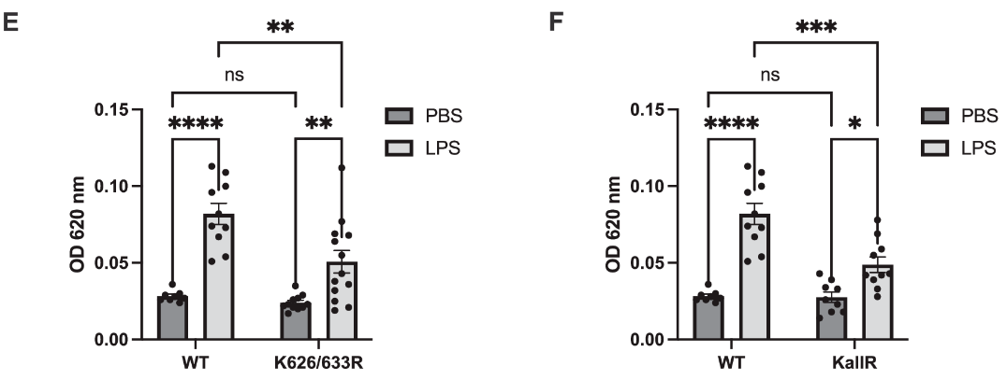
Histamine- and LPS-induced vascular permeability are impaired in VE-cadherin K626/633R and KallR knock-in mice
local intradermal injections of histamine in mice that had been i.v. injected with Evans blue induced strong leakiness in WT mice
the phenomenon partially reduced in VE-cadherin K626/633R mice.

Slide 9
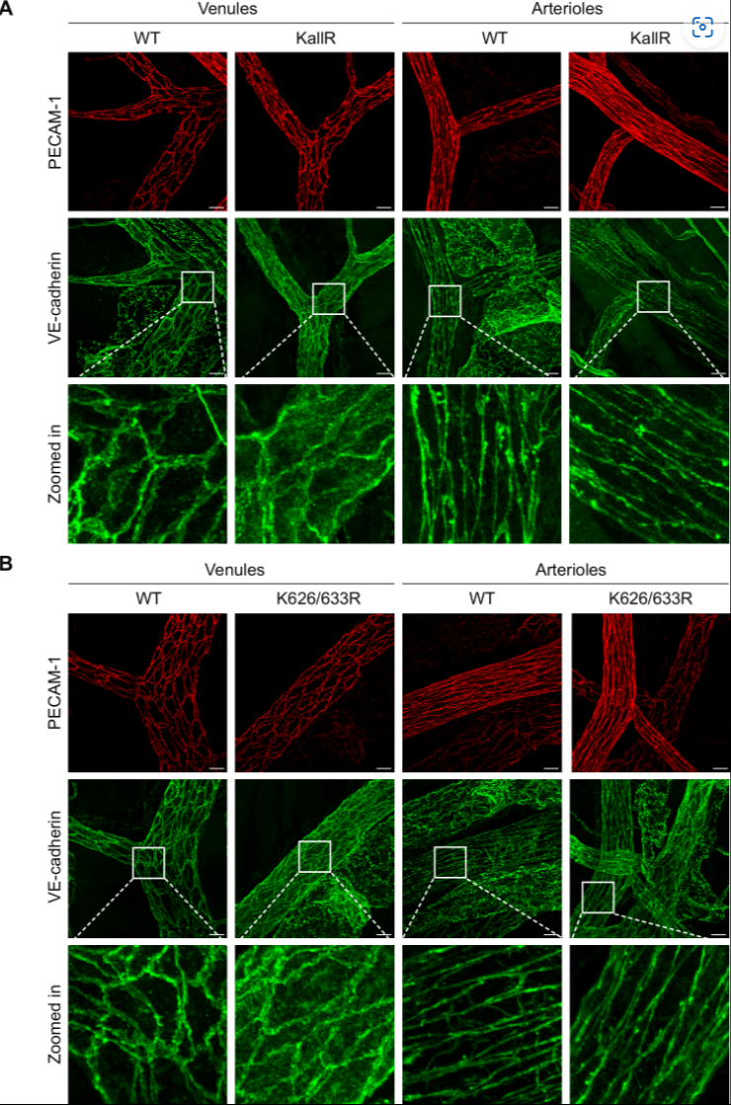
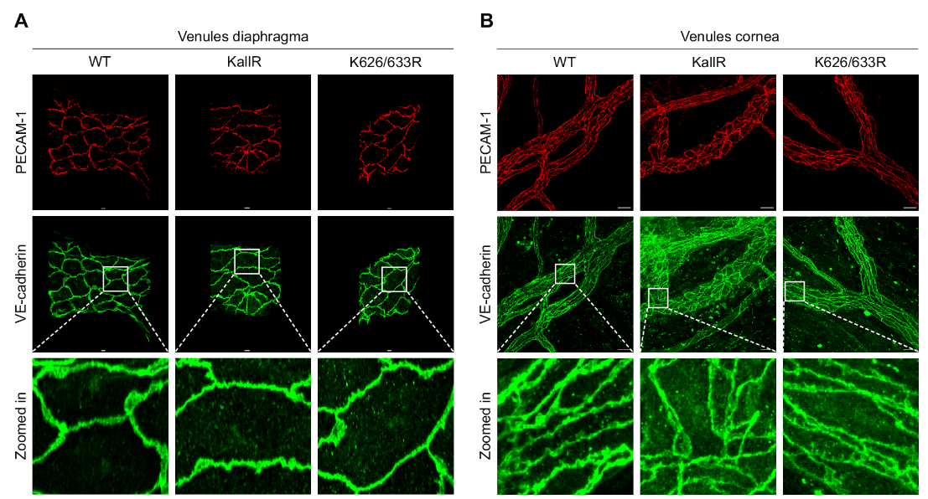
Besides endocytosis, the K626/633R mutation of VE-cadherin impairs lysosomal clearing of intracellular VE-cadherin

Slide 10
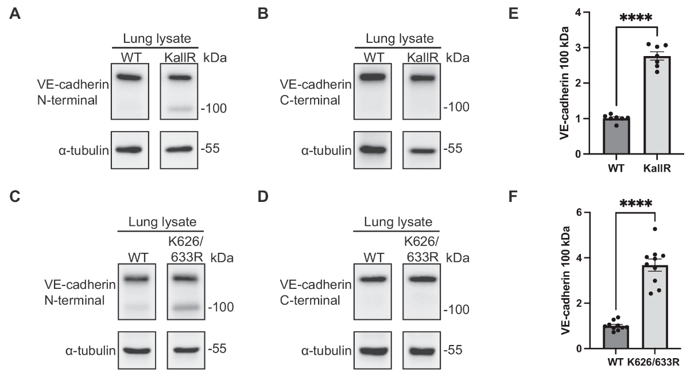
an accumulation of a 100 kDa fragment of VE-cadherin in the lung lysates of these mice.
This fragment was much more weakly seen in WT mice.
only antibodies against the N-terminus of VE-cadherin recognized the fragment

